Slide 1
BRYOPHYTA - RICCIA
Gopal Krishna Gokhale College, Kolhapur
Department of Botany
F.Y.B.Sc.
Dr. R.P. Jadhav M.Sc., M.Phil., Ph.D.
HOD, Dept. of Botany, G.K.G. College, Kolhapur

Slide 2
Riccia –Thallus

Slide 3
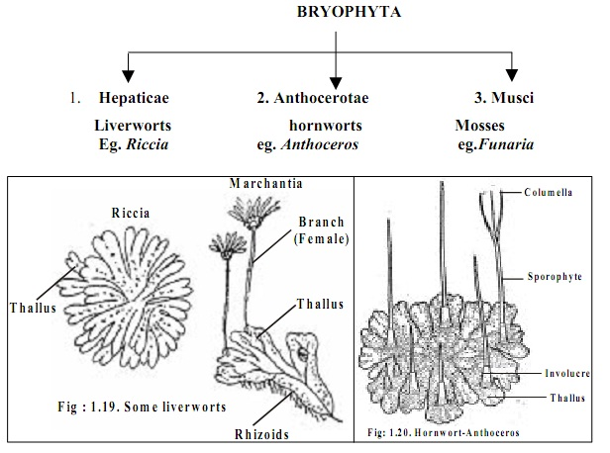

Slide 4
Riccia Vegetative Reproduction-

Slide 5
Riccia Internal Structure / V.S. Thallus :

Slide 6
Riccia Thallus

Slide 7
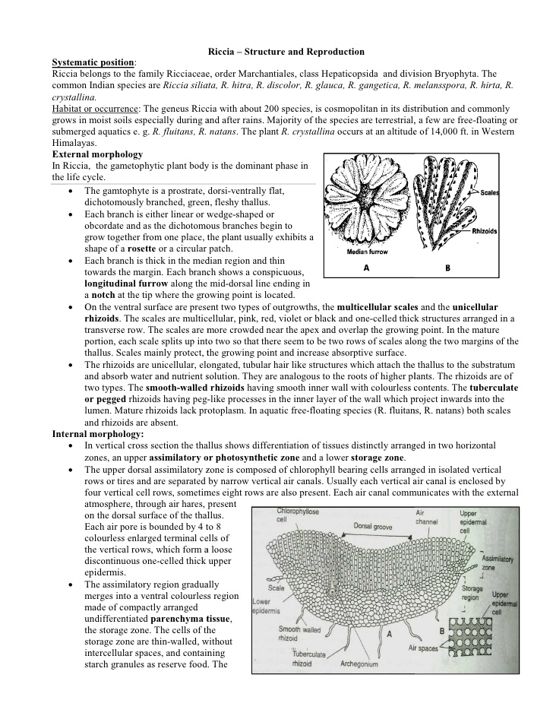

Slide 8
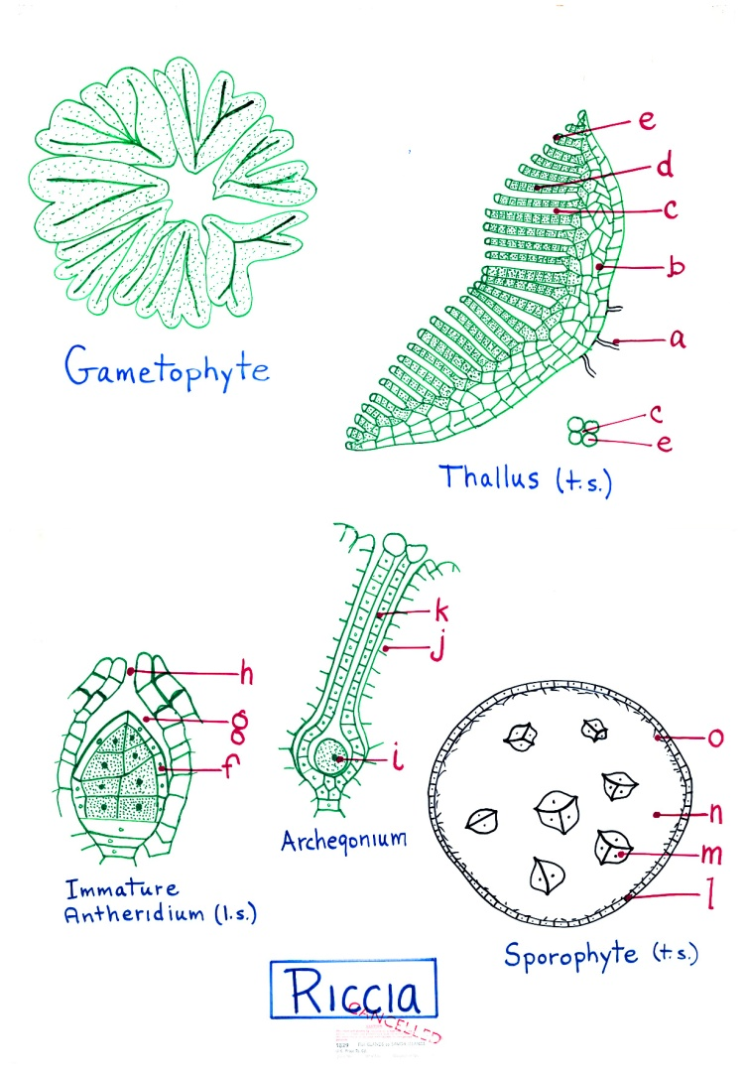

Slide 9
V.S. Of Riccia Thallus -

Slide 10
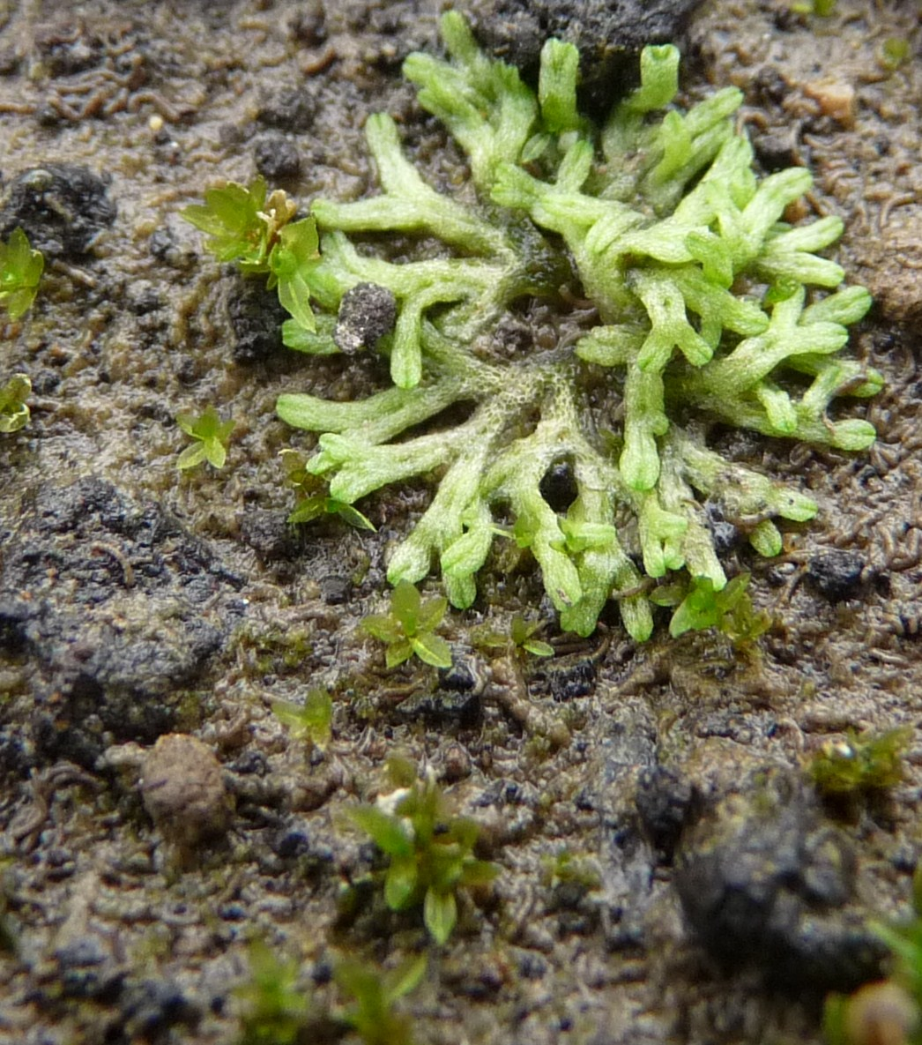

Slide 11
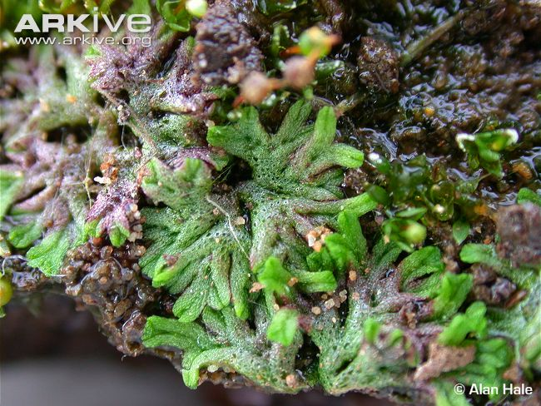

Slide 12
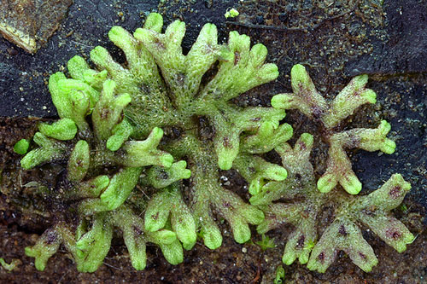

Slide 13
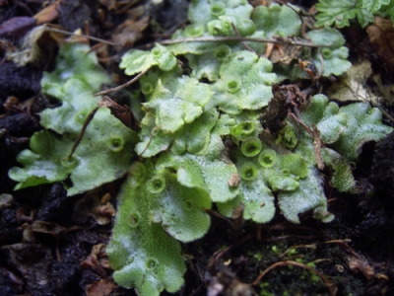

Slide 14
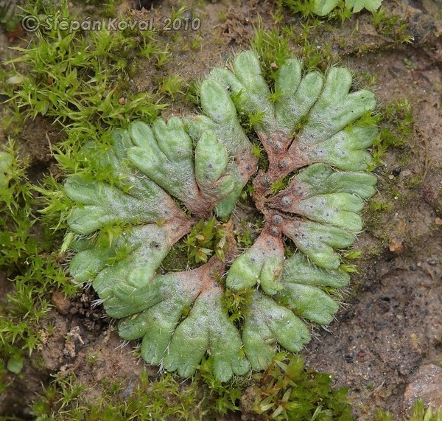

Slide 15
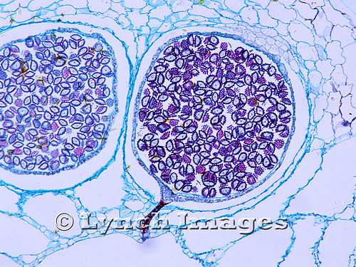

Slide 16
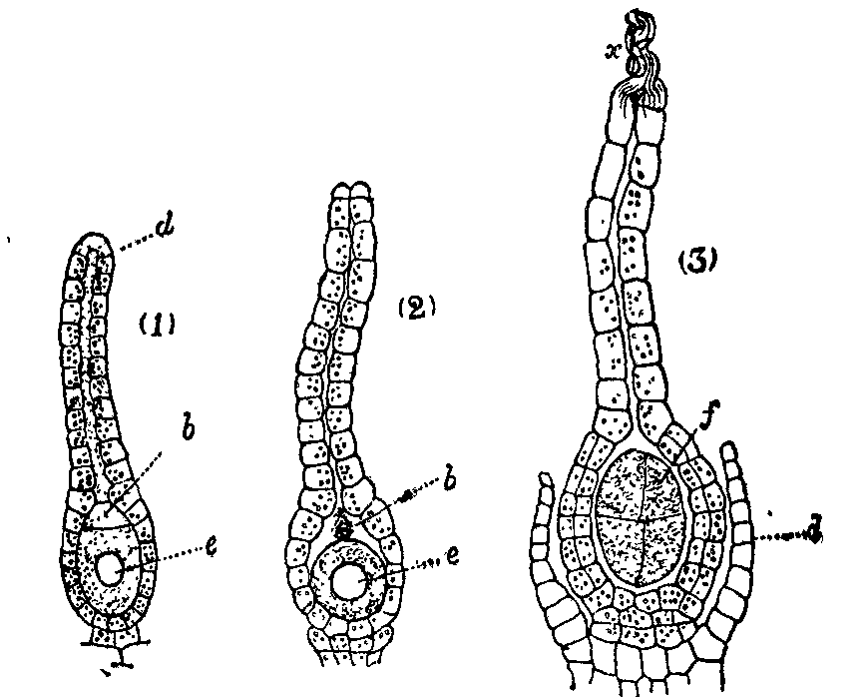

Slide 17
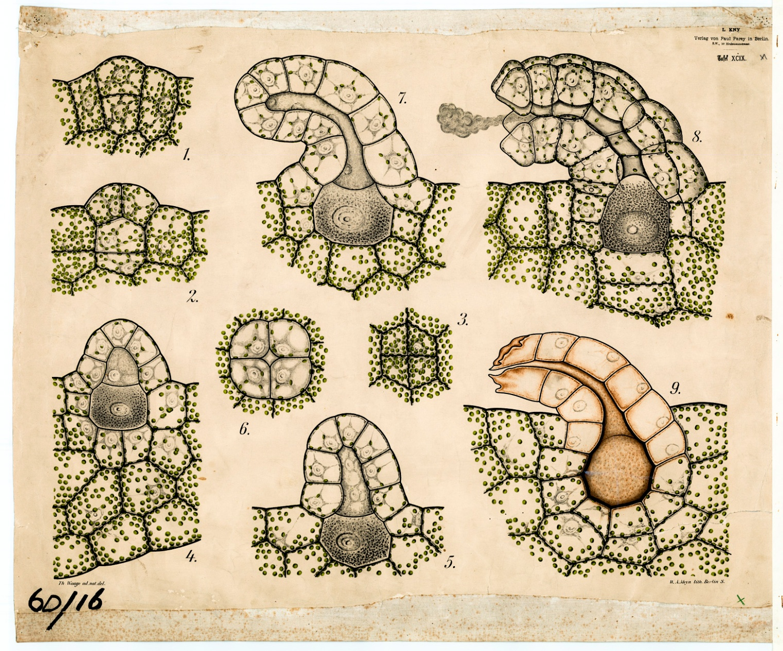

Slide 19
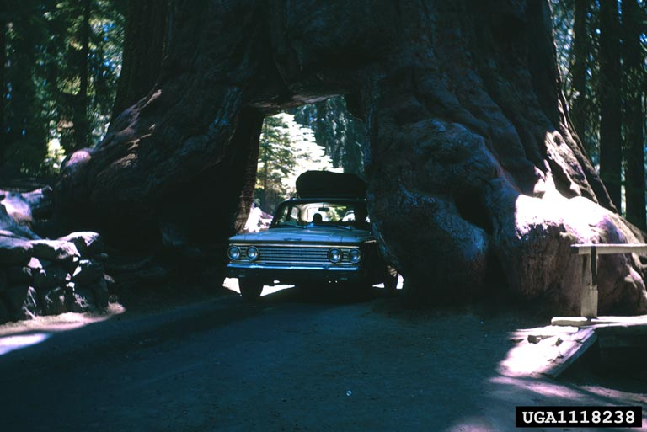
Thank You

